Slide 1
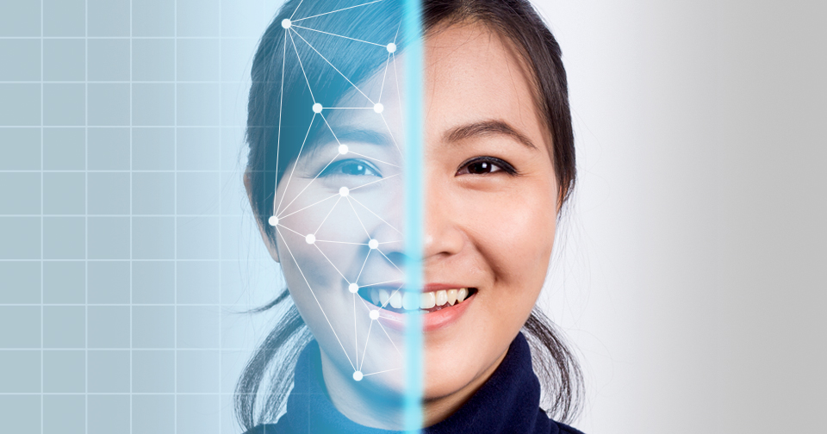
FACial EMOTION RECOGNITION USING FACE-API
TEAM MEMBERS:
DIVYA SRI.G [REGISTER NO:211418104056]
HUMSIKA.R [REGISTER NO:211418104087]
KEERTHANA THILAGAM.D [REGISTER NO:211418104120]
GUIDE: DR. R. JOSEPHINE LEELA
DESIGNATION:PROFESSOR

Slide 2
INTRODUCTION
Facial emotion detection is one of the most common applications of Artificial Intelligence. There are many attempts to make an automatic facial expression analysis tools as it has application in many different fields such as robotics, medicine, driving assist systems, and lie detector.
Facial recognition is a way of recognizing or verifying a person’s identity by looking at their face. It identifies people in photos, videos, or real-time using facial recognition systems.
In our project, we will be using face-api.js which is a JavaScript API for face detection and face recognition in the browser implemented on top of the tensorflow.js

Slide 3
LITERATURE SURVEY
TITLE | AUTHOR | METHODOLOGY | MAJOR FINDINGS
FACIAL EXPRESSION RECOGNITION USING FACE REGIONS | K. Lekdioui, Y. Ruichek, R. Messoussi, Y. Chaabi and R. Touahni | LBP, CLBP, LTP, Dynamic LTP and SVM classifier. | Reduction in computational complexity of the algorithm
AN EMOTION RECOGNITION SYSTEM FOR MOBILE APPLICATIONS | M. Shamim Hossain; Ghulam Muhammad | GMM (Gaussian mixture model) based classifier, Viola-Jones algorithm | Better Performance with higher accuracy
A SURVEY: SOFTWARE API AND DATABASE FOR EMOTION RECOGNITION | Renuka S. Deshmukh, Prof. Vandana Jagtap | CNN,LBP,… | Attributes, methods and emotional labels that are considered by various emotion API system .the databases available for inferring emotion through human facial features.
FACIAL EMOTION RECOGNITION | Ma Xiaoxi; Lin Weisi; Huang Dongyan; Dong | SVM, Deep Boltzmann Machine (DBM) | Better performance
FACIAL EMOTION RECOGNITION USING DEEP CONVOLUTIONAL NETWORKS | Hossein Khaliliardali, Mostafa Mohammadpour, Seyyed Mohammad. R Hashemi, Mohammad. | Geometric feature-based methods and appearance-based methods | Deep CNNs are able to learn characteristics of facial expression and increase facial emotion recognition accuracy.
FACE RECOGNITION FROM VIDEO USING DEEP LEARNING | Saibal Manna ,Sushil Ghildiyal, Kishankumar Bhimani | Data collection, FaceNet, Triplet loss function | Easy to implement & can recognize the side face and blurred image that other conventional models can’t recognize, can be incorporated in home security systems, visitor analysis systems as well.

Slide 4
PROBLEM DEFINITION
Human facial expressions can be easily classified into 7 basic emotions: happy, sad, surprise, fear, anger, disgust, and neutral.
Our facial emotions are expressed through activation of specific sets of facial muscles.
These sometimes subtle, yet complex, signals in an expression often contain an abundant amount of information about our state of mind.
Through facial emotion recognition, we are able to measure the effects that content and services have on the audience/users through an easy and
low-cost procedure.

Slide 5

HARDWARE REQUIREMENTS:
Processor : i3 or more
RAM :4 GB or more
The Visual Studio IDE is a creative launching pad that you can use to edit, debug, and build code, and then publish an app.
JavaScript is used by programmers across the world to create dynamic and interactive web content like applications and browsers.
SOFTWARE REQUIREMENTS:
Operating System : Windows 7 / 8 / 10
Language : HTML, CSS
Developing Tool : Visual Studio
Technologies : JavaScript

Slide 6
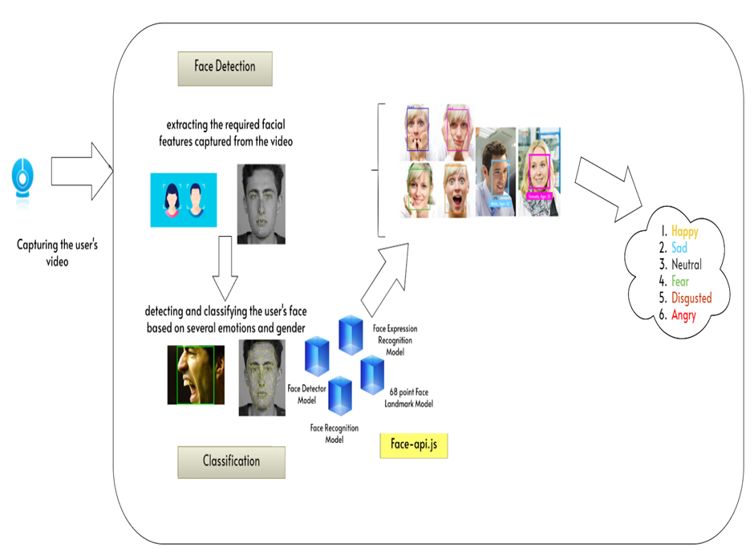
SYSTEM ARCHITECTURE

Slide 7
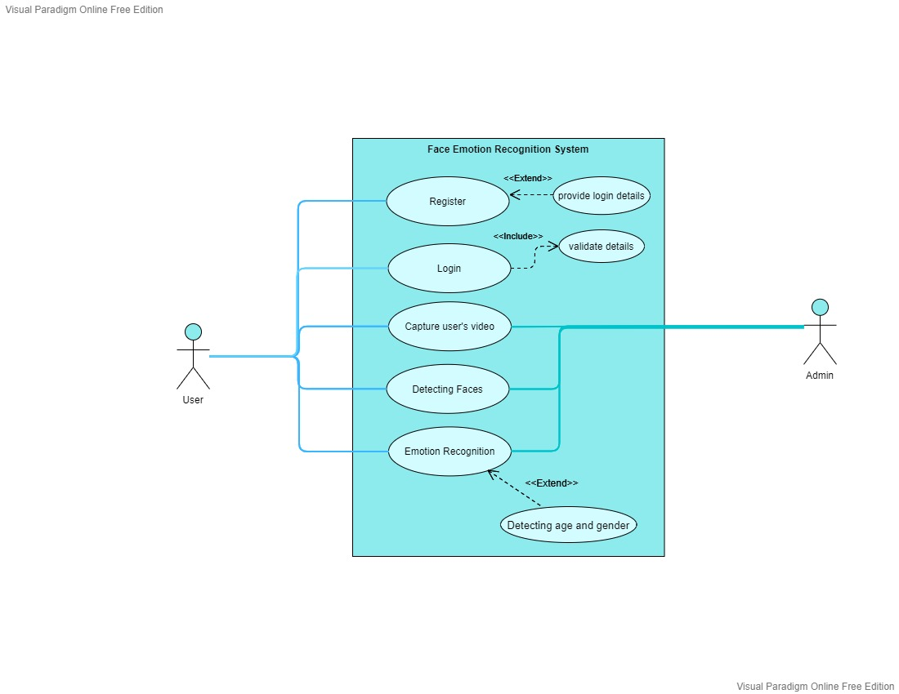
System Design
USE CASE DIAGRAM

Slide 8
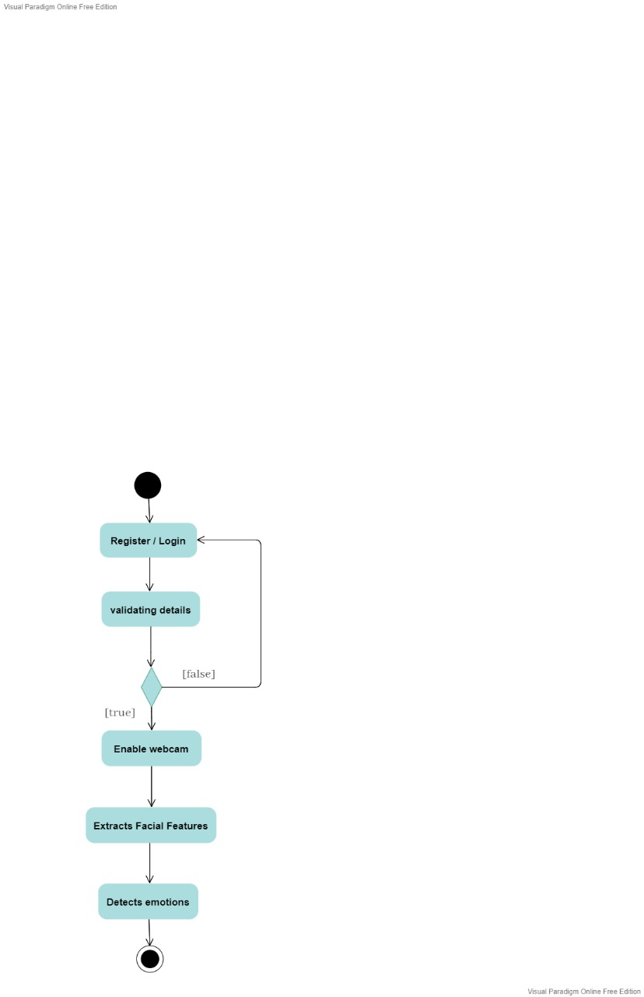
ACTIVITY DIAGRAM

Slide 9
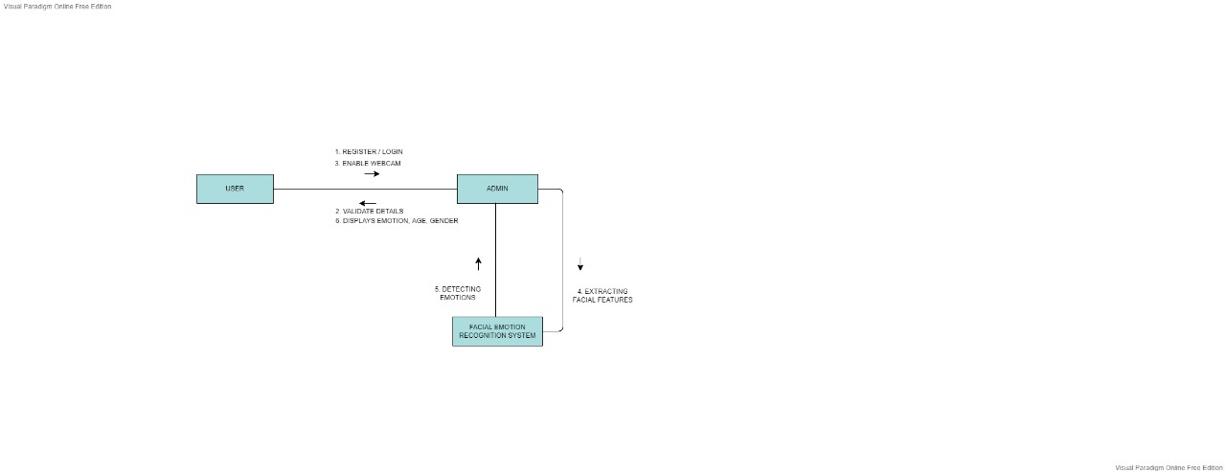
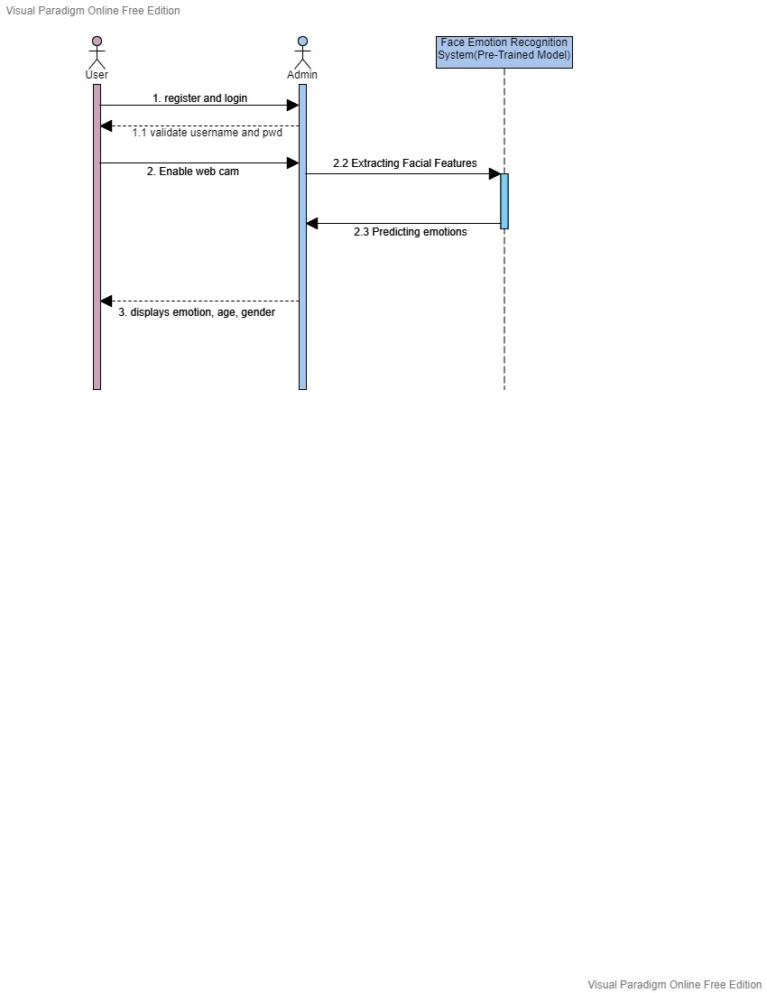
SEQUENCE DIAGRAM
COLLABORATION DIAGRAM

Slide 10
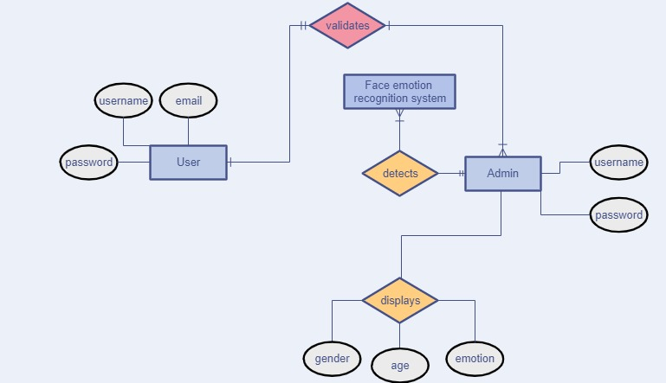
ER DIAGRAM

Slide 11


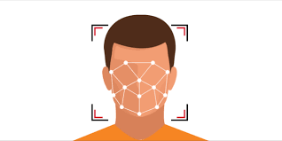
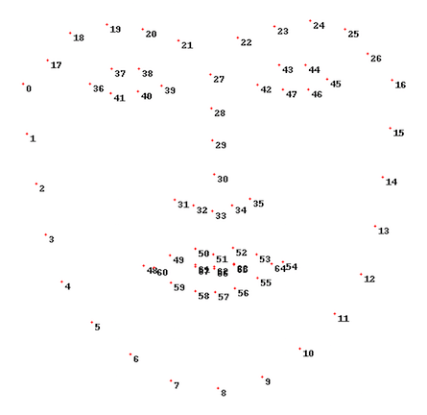

Modules
Registration Face detection
Feature extraction
Facial emotion recognition

Slide 12
Module: Registration
For new user, they can register using their mail id, name and password.
When the conditions doesn’t match for password, a error message is promoted.
When all the conditions match, “Registration successful”
message is shown.
For existing user, he/she is able to login into the system by giving their correct
details.
The user credentials will be validated by the system.
After authentication, the user is directed to the landing page where the
webcam is enabled with permission.

Slide 13
MODULE: FACE DETECTION
This module helps us to identify and extract parts of the user’s face from videos or image should be focused on.
Using the Tiny Face Detector model, the user’s face will be located and returned as bounding boxes.
This model has been trained to predict bounding boxes of each individual’s face.

Slide 14
MODULE: FEATURE EXTRACTION
For extracting the facial feature, we are making use of 68 Point Face Landmark model.
This pre-trained landmark detector identifies 68 points ((x, y) coordinates) in an individual’s face.
These points localize the region around the user’s eyes, brows, nose, mouth, chin and jaw.

Slide 15
MODULE: EMOTION RECOGNITION
Emotion recognition is the task to analyze, interpret and classify human emotion through the analysis of facial features.
This module uses a pre-trained face expression model to classify seven emotions (happy, sad, angry, disgusted, neutral, surprised, fear) along with estimating age and gender using age and gender model.
Using the face expression recognition model the emotion of users are detected.
It is lightweight, fast and provides reasonable accuracy. The model has a size of roughly 310kb It has been trained on a variety of images from publicly available datasets as well as images scraped from the web.

Slide 16
MODELS
There are four models for face detection and face recognition in the browser.
FACE DETECTION MODEL:
Tiny Face Detector : Bounding boxes appear for all the detected faces. We can compute the Euclidean distance between two face descriptors and judge whether two faces are similar based on a threshold value (for 150 x 150 sized face images 0.6 is a good threshold value).
68-POINT FACE LANDMARK DETECTION MODEL:
This model is used to track and locate the 68 facial points on a person’s face.
FACE EXPRESSION RECOGNITION:
Facial expression recognition is the task of classifying the expressions on face images into various categories such as anger, fear, surprise, sadness, happiness and so on.
AGE AND GENDER RECOGNITION MODEL:
Age and gender classification is a dual-task of identifying the age and gender of a person from an image or video

Slide 17
PERFORMANCE ANALYSIS
TEST CASES & REPORTS:
Test Case: Registration
Test Priority: High
Module: Face Detection
Test Priority: High
S.no | Action | Inputs | Expected Result | Actual Result | Testcase: Pass/fail
1 | Launch Application | Click button | Home page | Home page | Pass
2 | Enter correct email, name and password | Enter email id, Password and Name | Login successful | Login successful | Pass
3 | Enter wrong name and password | Enter wrong username and password | Prompts invalid username and password | Prompts invalid username and password | Pass
4 | Submit button | Click button | Login successful | Login successful | Pass
S.no | Action | Inputs | Expected Result | Actual Result | Testcase: Pass/fail
1 | Open webcam | Click button to start | Open webcam | Opens webcam | Pass
2 | Capture Video | User face | User’s face is captured through video | User’s face is captured through video | Pass
3 | Detect faces with Bounding boxes | Face of user without any disturbance | Bounding boxed appears as a result of face being detected | Bounding boxed appears. | Pass
4 | Feature extraction | User’s face | 68-point face landmark model is used | 68-point face landmark model is used | Pass
5 | Detect more than 2 Faces | 3 people facing camera | Detects all people | Detects all people | Pass

Slide 18
Module: Emotion, Age and gender Recognition
Test Priority: High
S.no | Action | Inputs | Expected Result | Actual Result | Testcase: Pass/fail
1 | Detect Happy as emotion with age and gender | Happy face | Emotion is recognized Happy | Emotion is recognized Happy | Pass
2 | Detect surprise as emotion with age and gender | surprised face | Emotion is recognized Surprised | Emotion is recognized surprised | Pass
3 | Detect sad as emotion with age and gender | sad face | Emotion is recognized sad | Emotion is recognized sad | Pass
4 | Detect anger as emotion with age and gender | Angry face | Emotion is recognized as angry | Emotion is recognized as angry | Pass

Slide 19
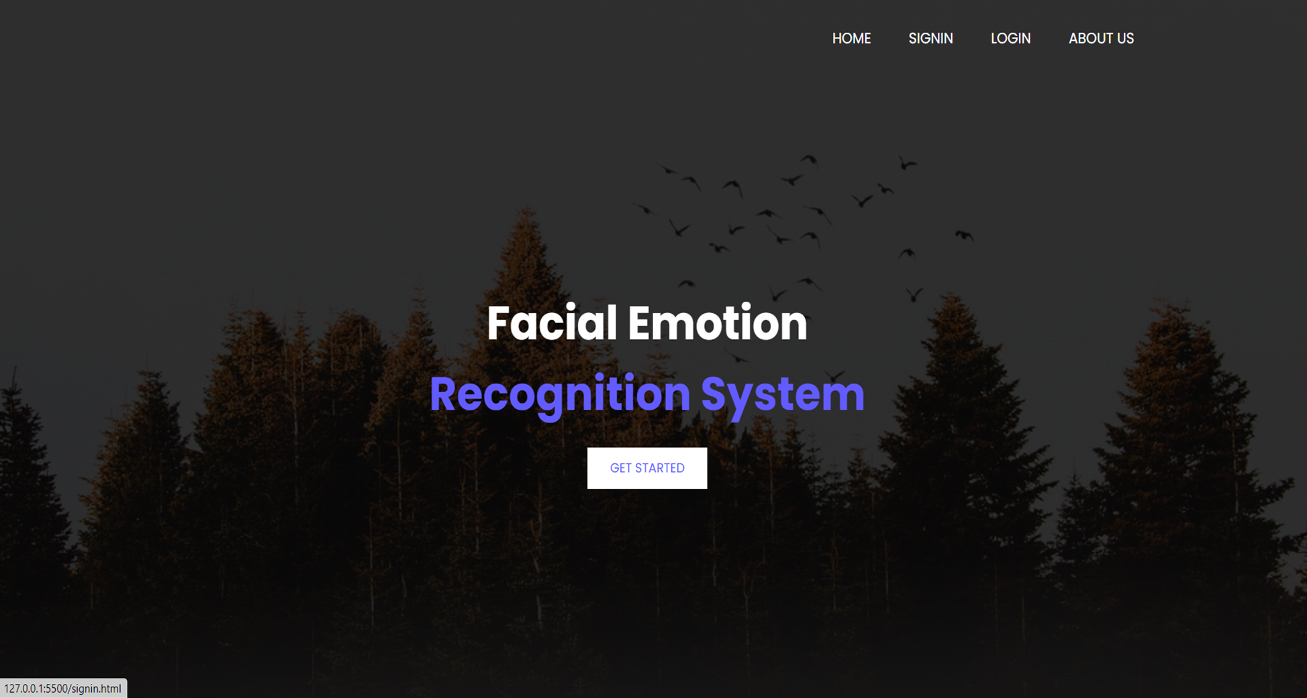
Screen shots
HOME PAGE

Slide 20

REGISTRATION PAGE

Slide 21
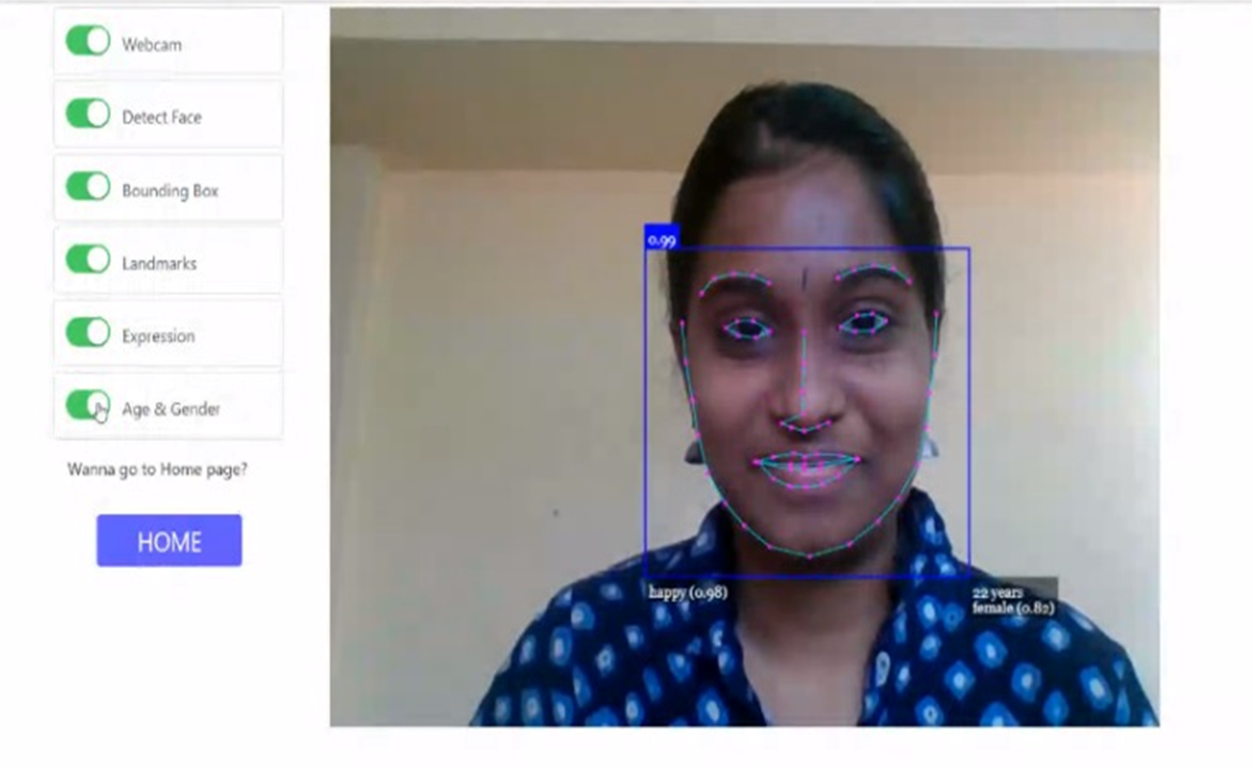
EMOTION AS “HAPPY” WITH AGE AND GENDER IS RECOGNIZED

Slide 22
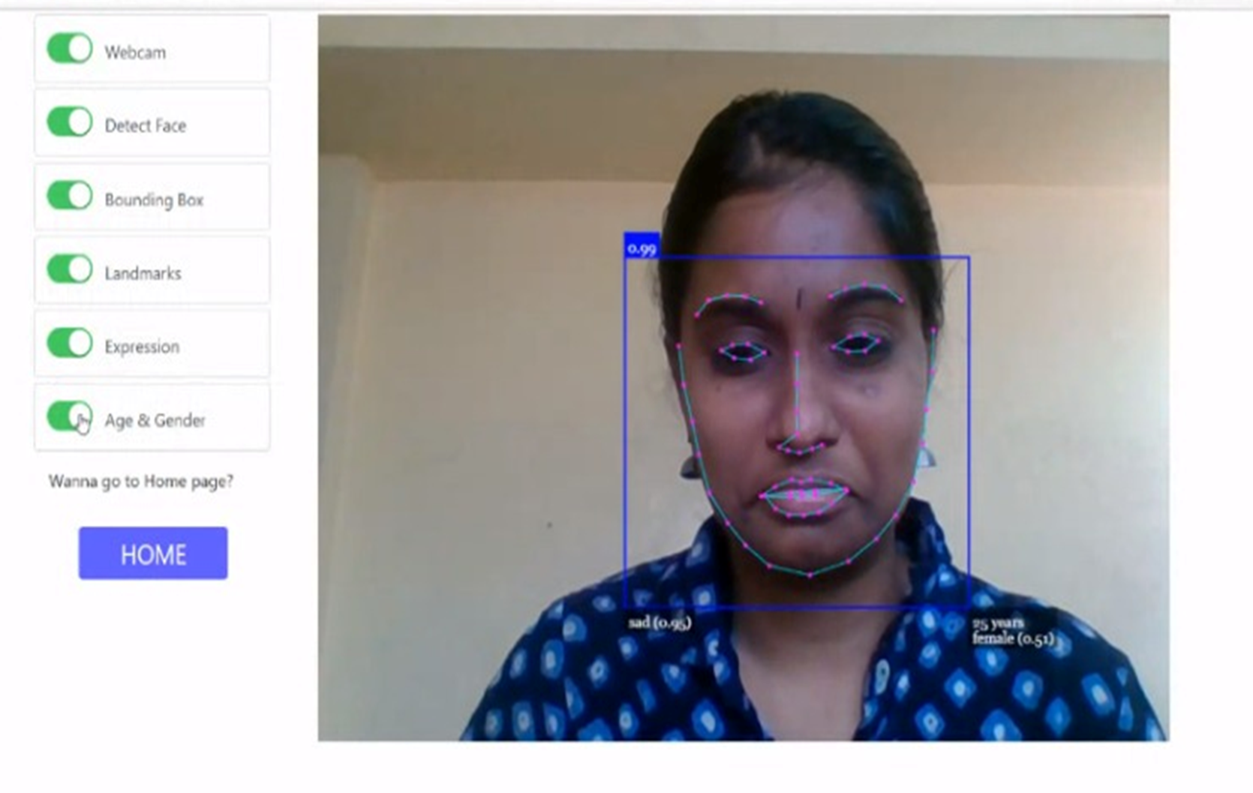
AGE ,GENDER AND EMOTION AS “SAD” IS RECOGNIZED

Slide 23
CONCLUSION
Facial emotion recognition systems are laying the foundation for a variety of applications that could be beneficial to the world.
The simplicity of our project is one of its best features.
Our project is implemented using JavaScript and can be accessed directly using our preferred browser.
For Future Enhancement, the proposed work can be enhanced by increasing the number of possible expressions other than anger, fear, disgust, joy, surprise, sadness, and neutral.
Secondly, ECG signals can be used to detect emotions, resulting in higher accuracy.
As the facial expression recognition systems are becoming robust and effective in communications, many other innovative applications and uses are yet to be seen.

Slide 24
REFERENCEs
1. Khadija Lekdioui, Yassine Ruichek, Rochdi Messoussi, Youness Chaabi, Raja Touahni, YEAR: May, 2017 “Facial Expression Recognition Using Face-Regions”, 2017 International Conference on Advanced Technologies for Signal and Image Processing (ATSIP), DOI: 10.1109/ATSIP.2017.8075517
2. M. Shamim Hossain and Ghulam Muhammad, YEAR: February 2017, “An Emotion Recognition System for Mobile Applications”, Institute of Electrical and Electronics Engineering (IEEE), DOI: 10.1109/ACCESS.2017.2672829
3. Renuka S. Deshmukh and Prof. Vandana Jagtap YEAR: June,2017 “A Survey: Software API and Database for Emotion Recognition”, International Conference on Intelligent Computing and Control Systems (ICICCS), DOI: 10.1109/ICCONS.2017.82507273.
4. M.Xiaoxi, L. Weisi, H. Dongyan, D. Minghui and H. Li, "Facial emotion recognition," YEAR: August 2017,IEEE 2nd International Conference on Signal and Image Processing (ICSIP), 2017, pp. 77-81, doi: 10.1109/SIPROCESS.2017.8124509
5. M.Mohammadpour, H. Khaliliardali, S. M. R. Hashemi and M. M. AlyanNezhadi, YEAR: February 2017 "Facial emotion recognition using deep convolutional networks,"2017 IEEE 4th International Conference on Knowledge-Based Engineering and Innovation (KBEI), 2017, pp. 0017-0021, doi: 10.1109/KBEI.2017.8324974
6. S. Manna, S. Ghildiyal and K. Bhimani, YEAR : June,2020"Face Recognition from Video using Deep Learning," 2020 5th International Conference on Communication and Electronics Systems (ICCES), 2020, pp. 1101-1106, doi: 10.1109/ICCES48766.2020.9137927.

